Slide 1

Retrieval - Arrays
Work through the written questions at the top of the worksheet.
Each question has a certain number of marks. Pay attention to this!

Slide 2
LO1 – Read data from a text file in C# and manipulate its contents
LO2 – Write data from a C# program into a text file
LO3 – combine the use of reading and writing with structs to create cohesive solutions

Slide 3

Concept – txt
LO1 – Read data from a text file in C# and manipulate its contents
txt – Text files consisting of strings
Standard file type for reading in text files
LO2 – Write data from a C# program into a text file
LO3 – combine the use of reading and writing with structs to create cohesive solutions

Slide 4
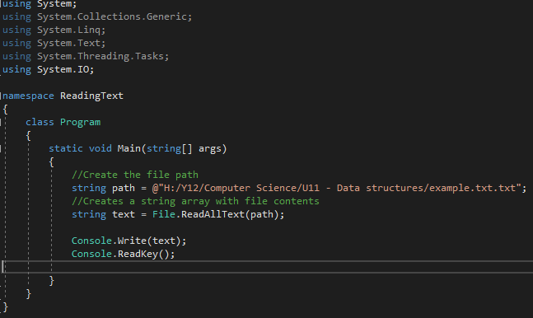
Concept – Reading txt in C#
LO1 – Read data from a text file in C# and manipulate its contents
LO2 – Write data from a C# program into a text file
LO3 – combine the use of reading and writing with structs to create cohesive solutions

Slide 5
Demonstrate - Task 1
LO1 – Read data from a text file in C# and manipulate its contents
Complete task 1 on the worksheet. Add screenshots of your code once completed.
LO2 – Write data from a C# program into a text file
LO3 – combine the use of reading and writing with structs to create cohesive solutions

Slide 6
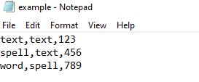
Concept – CSV
LO1 – Read data from a text file in C# and manipulate its contents
CSV – Comma Separated Values
Standard file type for reading in text files
LO2 – Write data from a C# program into a text file
LO3 – combine the use of reading and writing with structs to create cohesive solutions

Slide 7
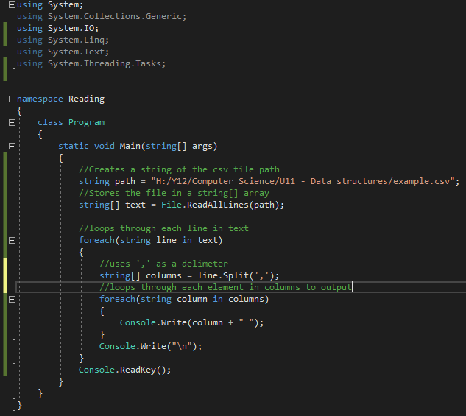
Concept – Reading csv in C#
LO1 – Read data from a text file in C# and manipulate its contents
LO2 – Write data from a C# program into a text file
LO3 – combine the use of reading and writing with structs to create cohesive solutions

Slide 8
Demonstrate - Task 3
LO1 – Read data from a text file in C# and manipulate its contents
Complete task 3 on the worksheet. Add screenshots of your code once completed.
LO2 – Write data from a C# program into a text file
LO3 – combine the use of reading and writing with structs to create cohesive solutions

